Slide 1

Rh Incompatibility
CLINICAL TEACHING

Slide 2
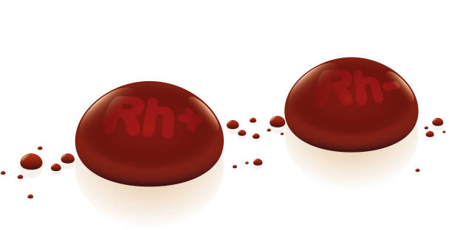
RH Factor
The Rhesus factor gets its name from experiments conducted in 1937 by scientists Karl Landsteiner and Alexander S. Weiner.
Their experiments involved rabbits which, when injected with the Rhesus monkey’s red blood cells, produced an antigen that is present in the red blood cells of many humans.

Slide 3
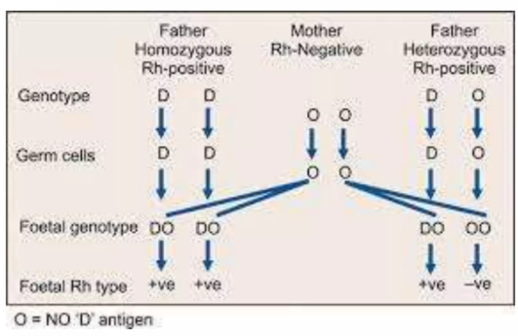
Genotype

Slide 4
Definition
Rh incompatibility is a condition which develops when there is a difference in Rh blood type between the pregnant mother (Rh negative) and the fetus (Rh positive).

Slide 5
Rh Type and Pregnancy
A person’s Rh type is generally most relevant in pregnancies.
If the pregnant woman and her husband are both Rh negative, there is no risk of Rh incompatibility.
If the mother is Rh negative and the husband is Rh positive, the baby may inherit the father’s Rh positive type, creating incompatibility.

Slide 6
Rh Type and Pregnancy
If some of the fetal blood enters the mother’s bloodstream, her body may produce antibodies. These antibodies could cross back through the placenta and harm the developing baby’s red blood cells.
Normally the placenta acts as a barrier to fetal blood entering maternal circulation. However, sometimes during pregnancy or birth, fetomaternal hemorrhage occurs. The woman’s immune system responds by producing anti-D antibodies, causing sensitization.

Slide 7
Causes
The difference in blood type between mother and baby causes Rh incompatibility only when the mother is Rh negative and baby is Rh positive.

Slide 8
Risk Factor
A previous pregnancy
An ectopic pregnancy, miscarriage, or induced abortion
A mismatched blood transfusion or stem cell transplant
An injection, puncture, or injury involving Rh positive blood

Slide 9
Pathophysiology
1st Pregnancy
First newborn RhD+ safe. But mother RhD- is now sensitized to RhD antigen
Father RhD+
Mother RhD-
Fetus RhD+
Fetal – maternal blood transfer during labour

Slide 10
Pathophysiology
2nd Pregnancy
Rapid production of IgG anti-D by mother
Maternal IgG anti-D crosses placenta
IgG anti D attaches to fetal BBC and marks them for destruction
Repeat encounter with Fetal RhD antigen
Increased bilirubin, CNS damage(kernicterus), death
Fetal or newborn hemolytic anemia

Slide 11
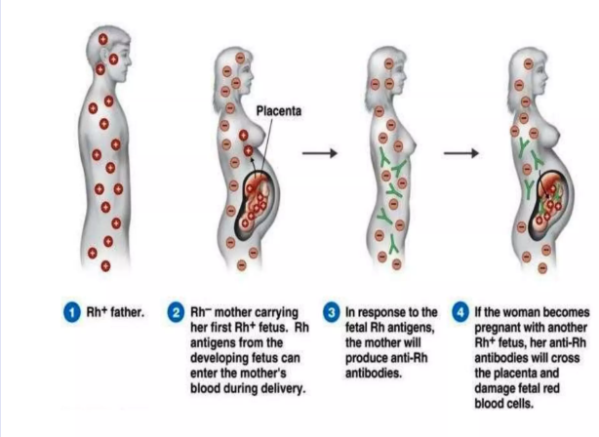
Pathophysiology

Slide 12
Diagnostic / laboratory tests:
Kleihauer–Betke test or flow cytometry
Indirect Coombs test
Direct Coombs test
Blood count
Bilirubin (direct & indirect)

Slide 13
Signs and Symptoms
Hemolysis
Jaundice
Generalized swelling (total body swelling)
Respiratory distress
Circulatory collapse
Kernicterus
These may occur several days after delivery; signs include poor feeding, decreased activity

Slide 14
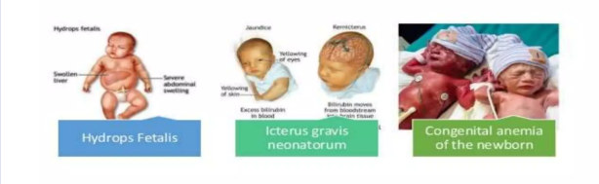
More severe forms / conditions:
Hydrops fetalis
Icterus gravis neonatorum
Congenital anemia of newborn

Slide 15
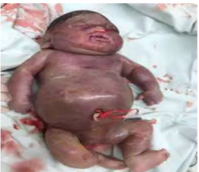
Hydrops Fetalis
This is a most serious form of Rh haemolytic disease. Excessive destruction of the fetal red cells leads to severe anaemia, tissue anoxaemia and metabolic acidosis

Slide 16
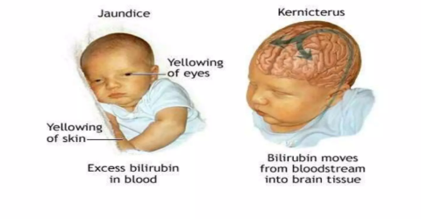
Icterus Gravis Neonatorum
This clinical entity is the effect of lesser form of fetal haemolysis. The baby is born alive without evidence of jaundice but soon develops it within 24 hours.

Slide 17
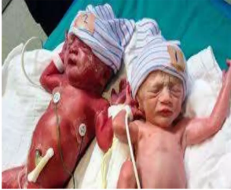
Congenital Anaemia
Mildest form of diseases where the haemolysis is going on slowly. Although anemia develops slowly within the first few weeks

Slide 18
Risk Factor and Causes
The nursing process for Rh incompatibility focuses on prevention and monitoring through assessment (determining blood type and Rh factor), diagnosis (identifying Rh incompatibility), planning (scheduling Rh immune globulin administration), implementation (giving shots at 28 weeks and postpartum, and performing monitoring tests), and evaluation (assessing for sensitization and fetal well-being). The primary goal is to prevent Rh-negative mothers from becoming sensitized by providing RhIG (Rhogam) to stop the development of antibodies against Rh-positive blood.

Slide 19
Risk Factor and Causes
Assessment
Identify Rh status: The most crucial first step is to determine the mother's blood type and Rh factor through early prenatal screening.
Assess for previous exposure: Inquire about any previous pregnancies, miscarriages, abortions, or trauma to the abdomen, as these events could lead to Rh sensitization.
Diagnosis
Identify the issue: The diagnosis is "Rh incompatibility" if an Rh-negative mother is carrying an Rh-positive fetus, which can trigger antibody production.
Planning
Prevent sensitization: The main nursing goal is to prevent Rh sensitization.
Administer Rh immune globulin (RhIG): A plan is made to administer RhIG (e.g., RhoGAM) to prevent the mother's immune system from creating antibodies.

Slide 20
Risk Factor and Causes
Implementation
Administer RhIG:
At 28 weeks: An RhIG shot is given to every Rh-negative mother, regardless of the baby's Rh status.
Postpartum: Within 72 hours of delivery, another shot is given if the baby is found to be Rh-positive.
After events: RhIG is also given after any event that could cause fetomaternal blood mixing, such as miscarriage, abortion, trauma, or invasive prenatal procedures like amniocentesis.
Monitor for antibodies: Perform regular antibody screenings to monitor for the development of antibodies.
Fetal monitoring: In cases of potential sensitization, use ultrasounds and Doppler scans to monitor the fetus for signs of anemia.
Evaluation
Confirm prevention: Evaluate if RhIG successfully prevented the mother from producing antibodies.
Assess for complications: If sensitization has already occurred, monitor the fetus for signs of anemia, hydrops fetalis, or other complications.
Educate the mother: Reinforce that RhIG is effective only before sensitization occurs and that these injections are necessary with each exposure to Rh-positive blood to prevent future complications.

Slide 21
Prevention
Administer Rh immunoglobulin after sensitizing events
Prevent mismatched transfusions
Use ultrasound before amniocentesis
Monitor Rh negative mothers throughout pregnancy

Slide 22
Treatment
Rh immunoglobulin (7th month & within 72 hrs postpartum)
Treat neonatal anemia (exchange transfusion / phototherapy if required)
Intrauterine transfusions in severe cases

